Slide 1
Gym Management System
Project
Irhamul Islam
1907093

Slide 2
Introduction
The main purpose of this project is to create a easy gym management
System both for admin and user
Main work of this project to handle users, equipments and stuff for admin.
And for user,one will be able to see his/her workouts, equipments in the gym and track of his physical health

Slide 3
Features
User/admin registration: One will be able to sign up giving the necessary info.If password is forgot,the it can be retrieved with security questions
Admin approval: After user sign up,admin has to approve by changing the status of user.After changing the status to true,only then user will be able to log in.Till then,user has to wait.
This project involves mainly–inserting data into database,Update data if necessary,delete,search & showing them in table

Slide 4
Features
Add new member
Update/delete member
List of members
Set workout
Add description of workouts
Manage Members
Verify users
& Payment
Add new stuff
Admin home
Manage Stuff
update/delete stuff
List of stuff
Add equipment
Manage Equipments
View equipment list

Slide 5
Features
See assigned workouts
Check height,weight and BMI
See available equipment in the gym
User home
Contact info of admins in case of any issue
Can check own info

Slide 6
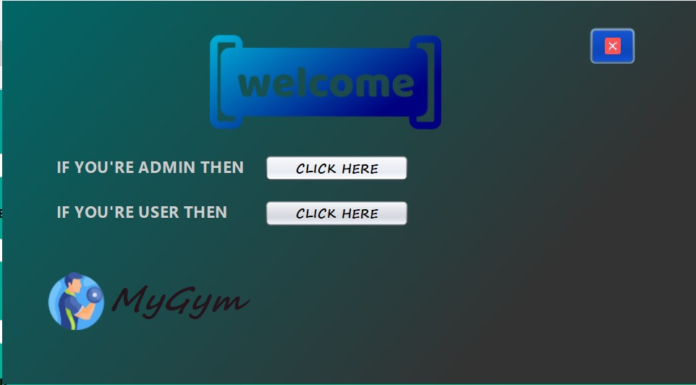
Start page
One will choose which page he/she would like to open

Slide 7
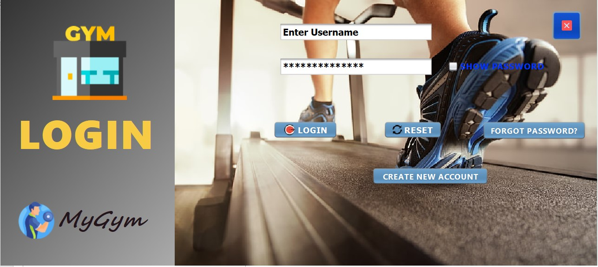
Admin Login

Slide 8
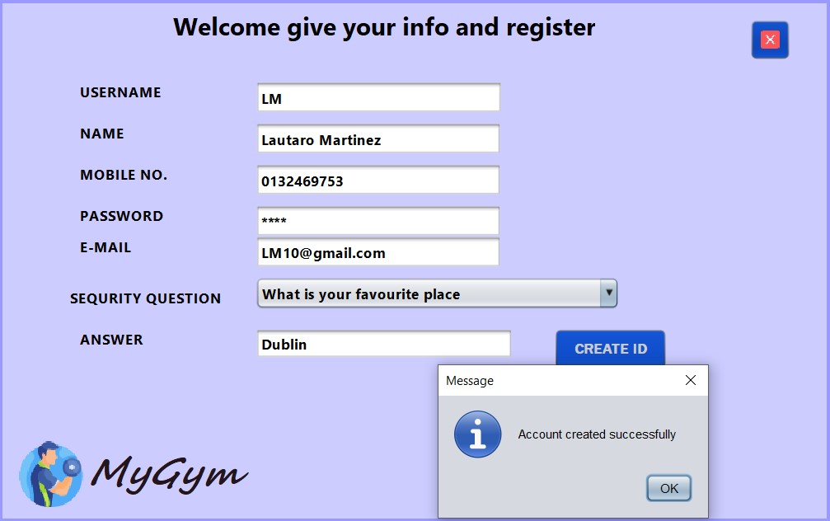
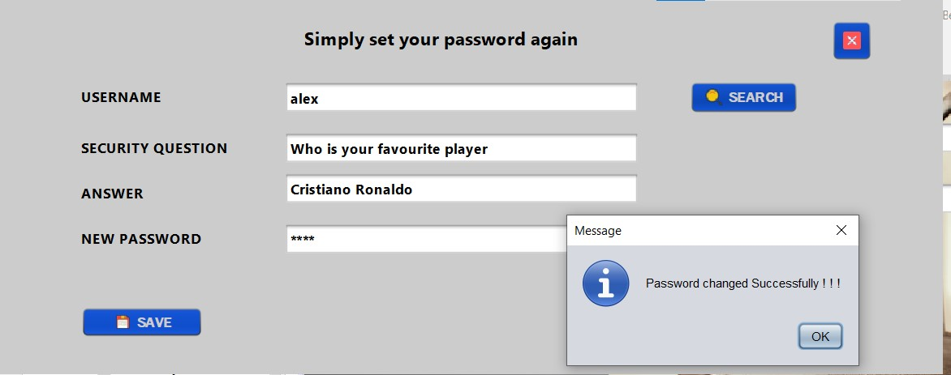
Admin sign up & forget password

Slide 9

Admin home
Here, admin has mainly 3 sections

Slide 10
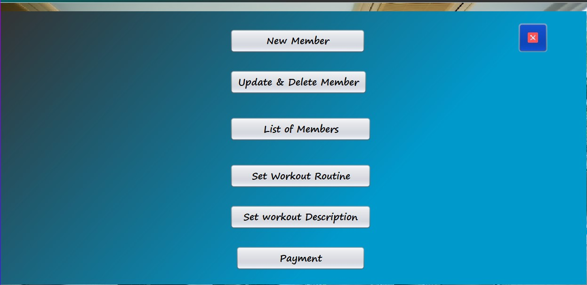
Manage Members

Slide 11
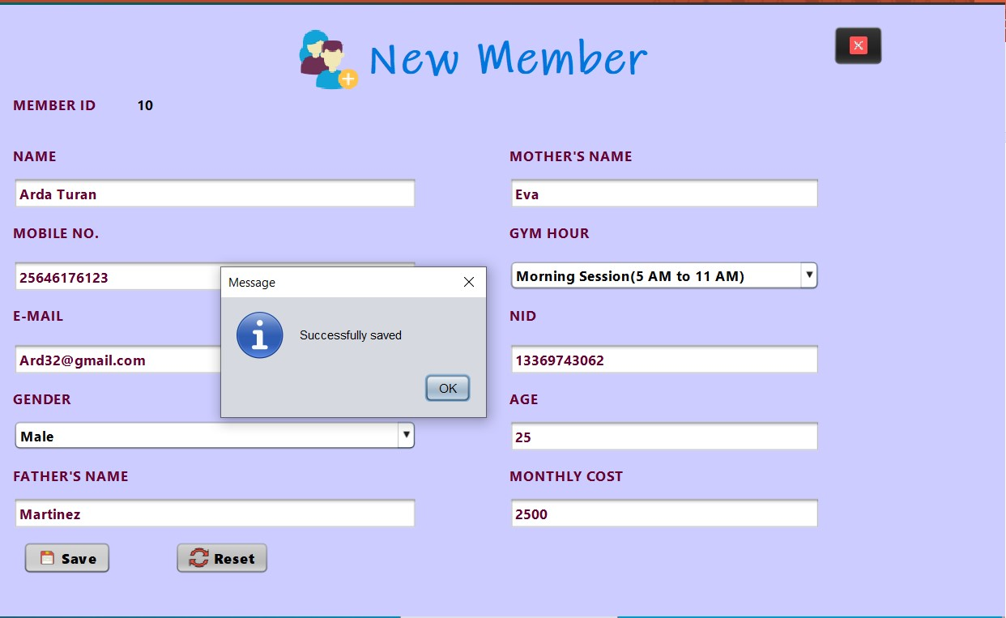
New Member
Id will be generated auto from database
Then after giving the info click save will simply add the member

Slide 12
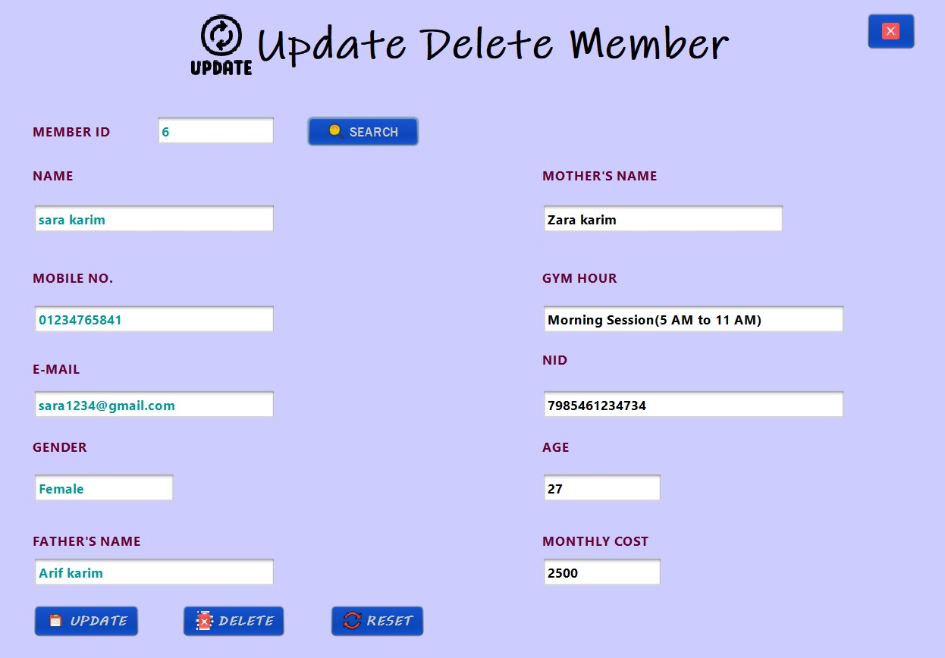
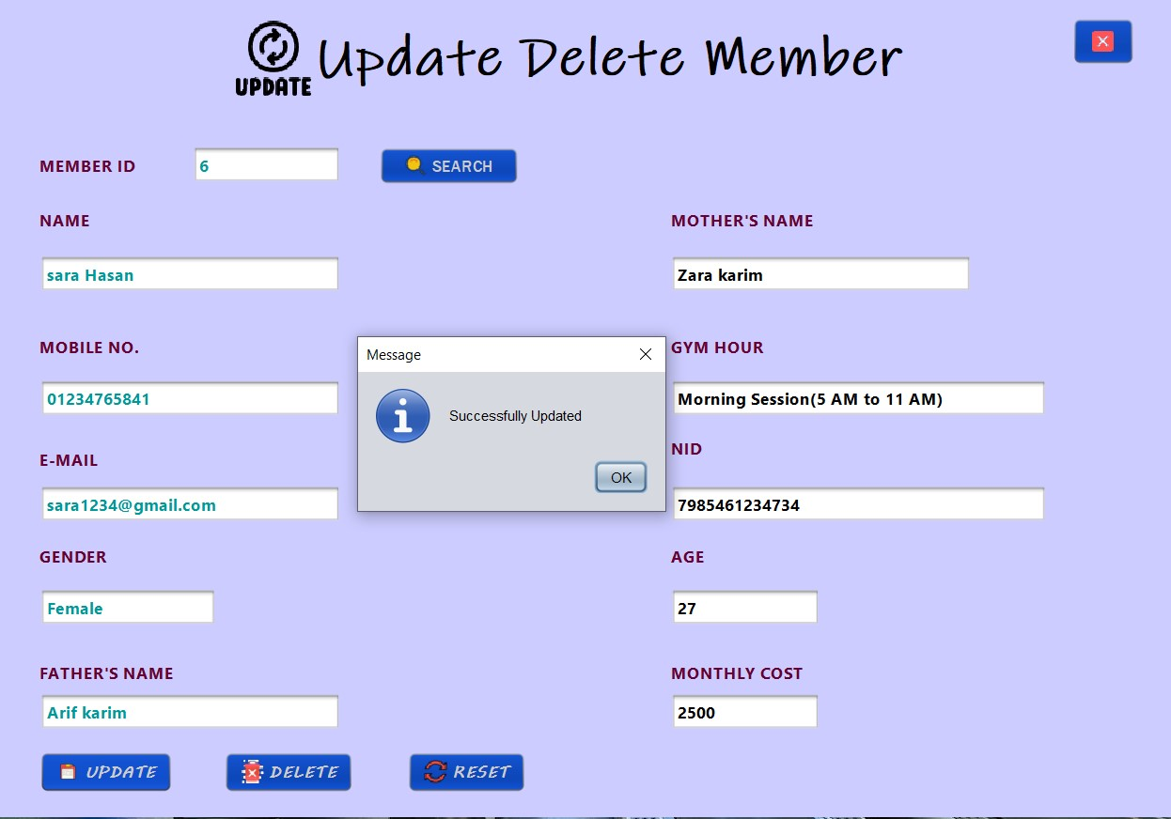
Update Member
First ,giving id no and search the member
Then change necessary info and click update

Slide 13
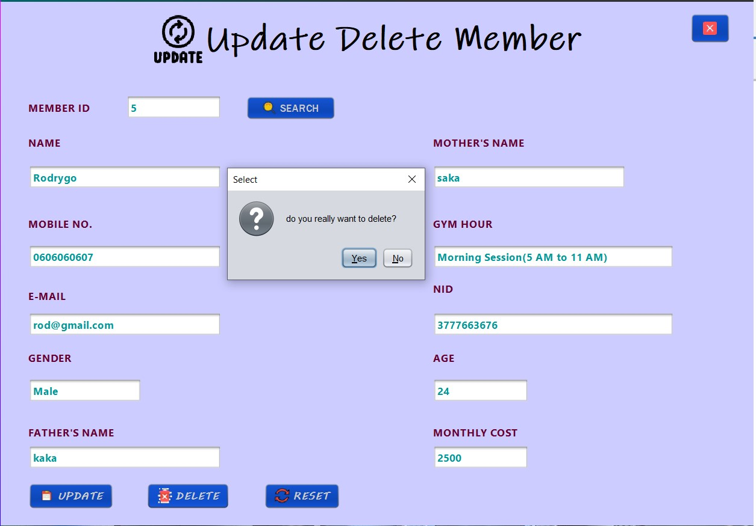
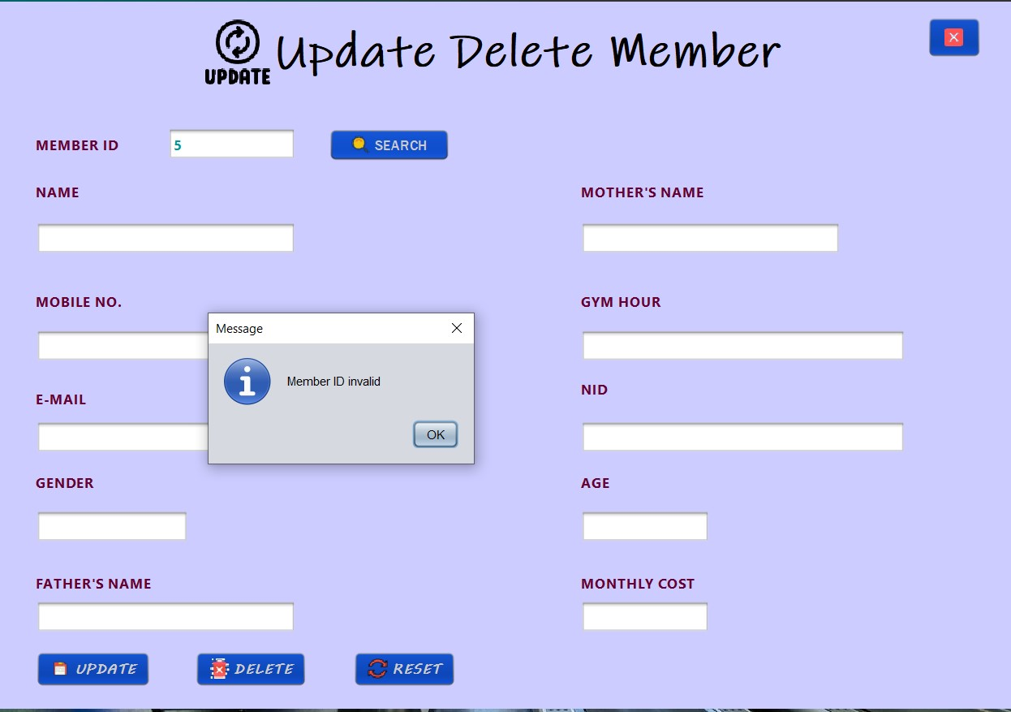
delete Member
First ,giving id no and search the member and click delete
On right side,same id is showing invalid as no longer exists

Slide 14
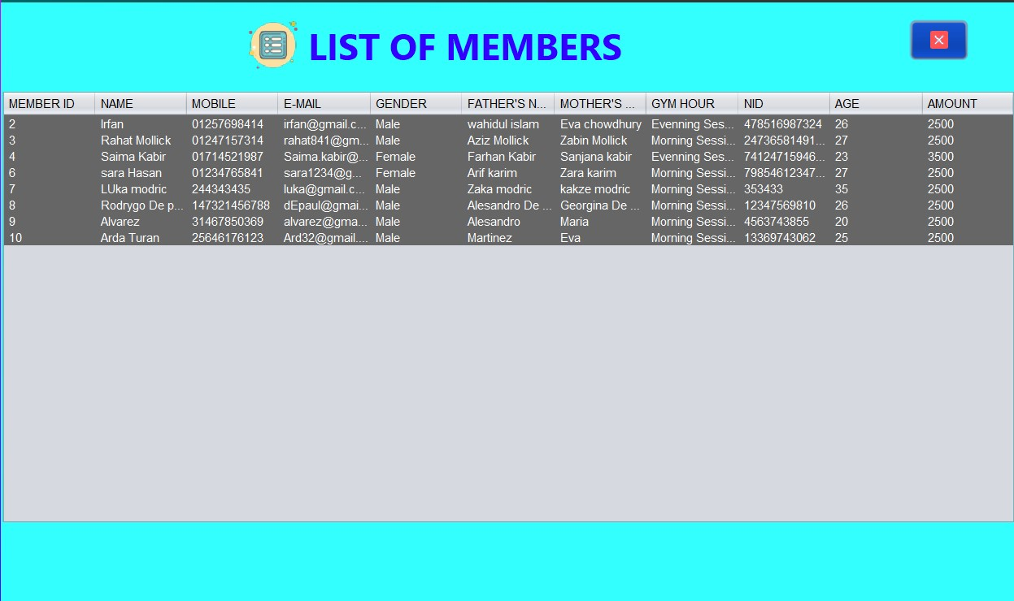
List of Members
A table is used to show the list of all available members.
Notice id 1,5 not there as it’s deleted

Slide 15
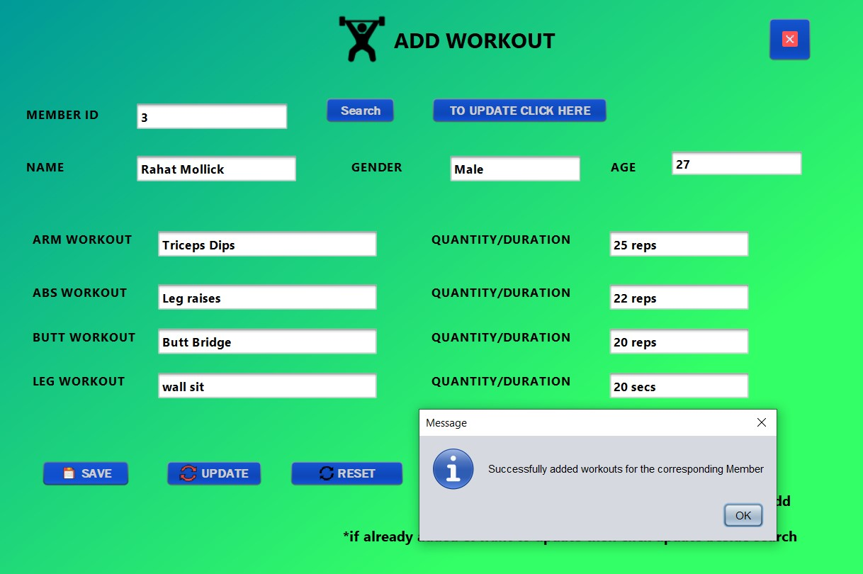
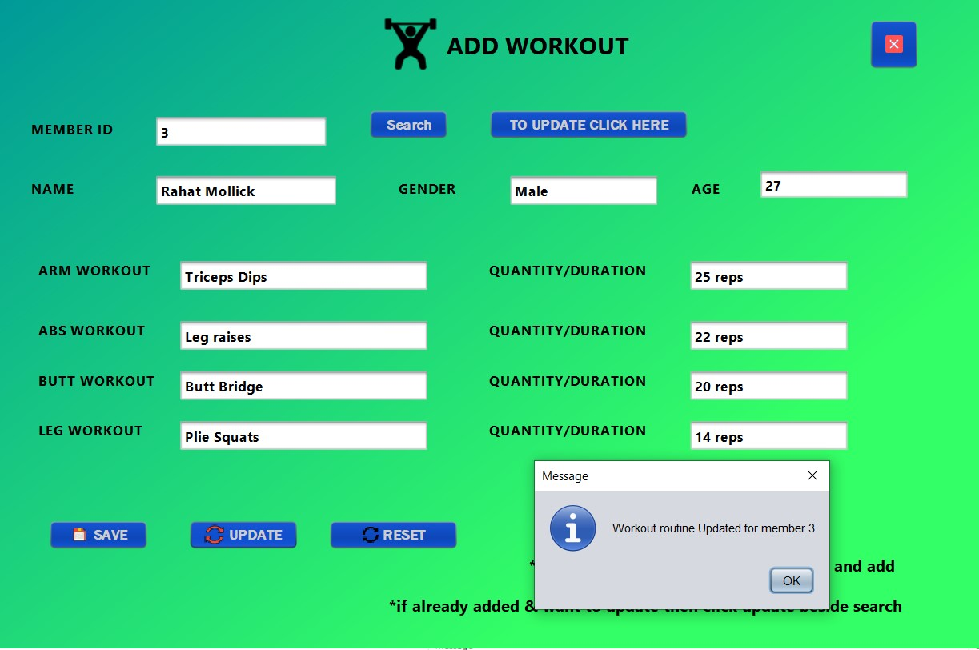
Add workout
On the left side workout is being assigned for the first time
On the right side it’s updated

Slide 16
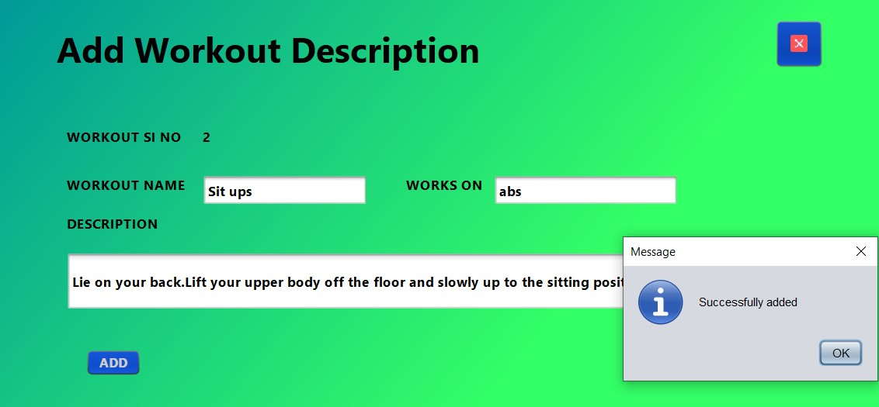
Add workout description
Adding short introduction/instruction about a workout

Slide 17
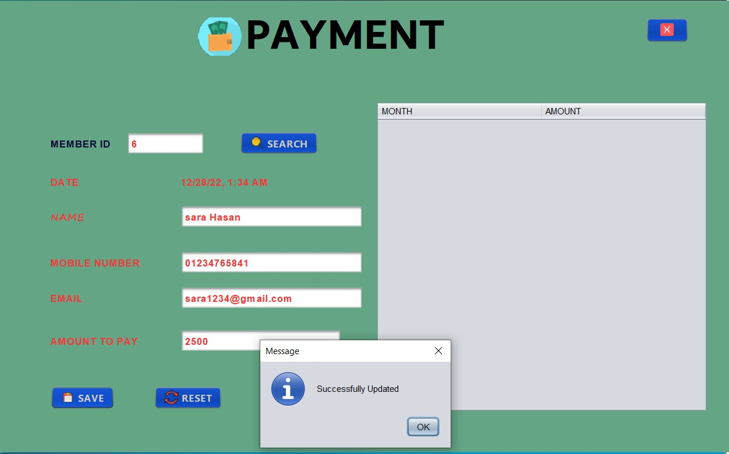
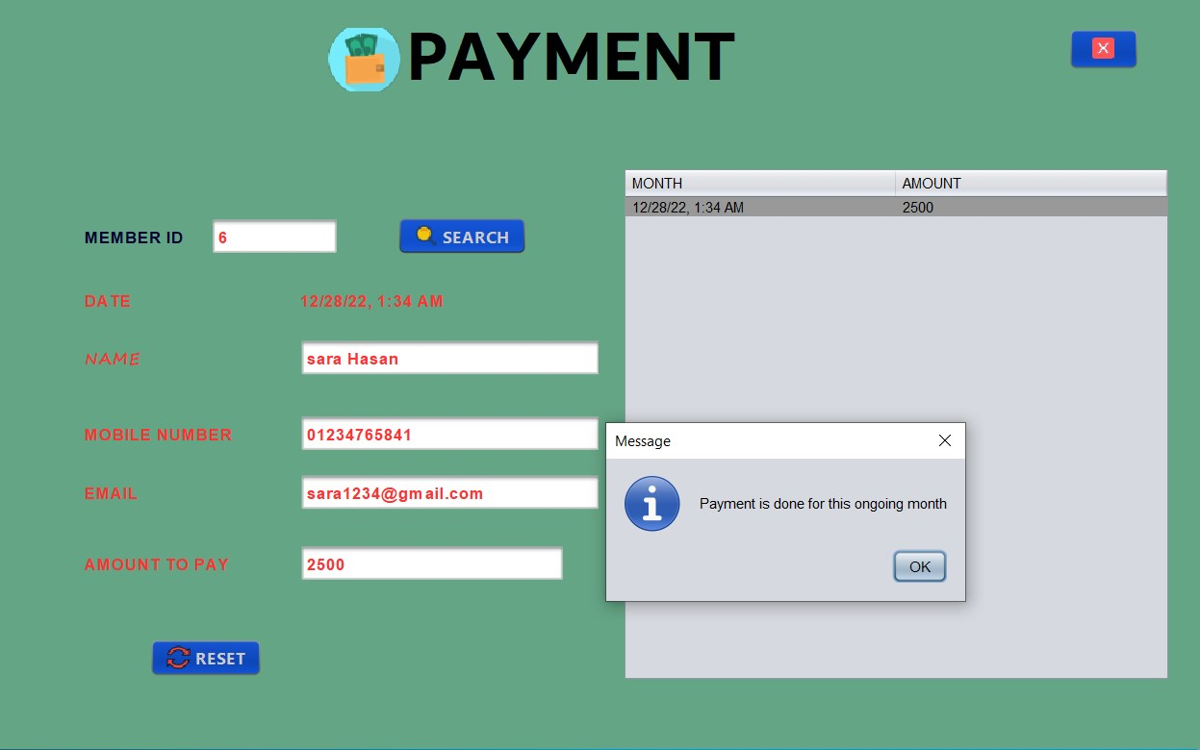
Payment
For id 6,payment is being done on the left side
On the right side,after payment is showing payment is already done

Slide 18
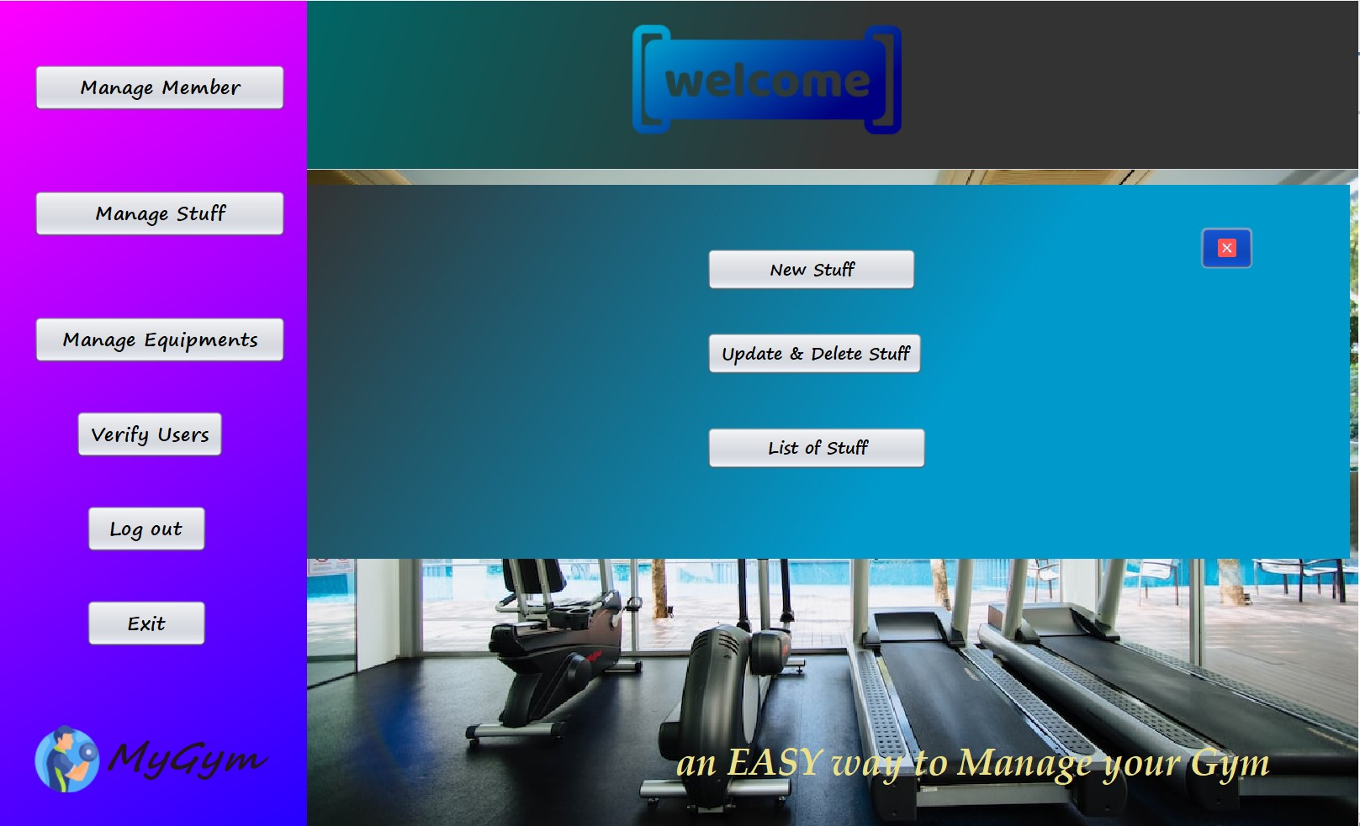
Manage Stuff
These 3 works can be done in manage stuff section

Slide 19
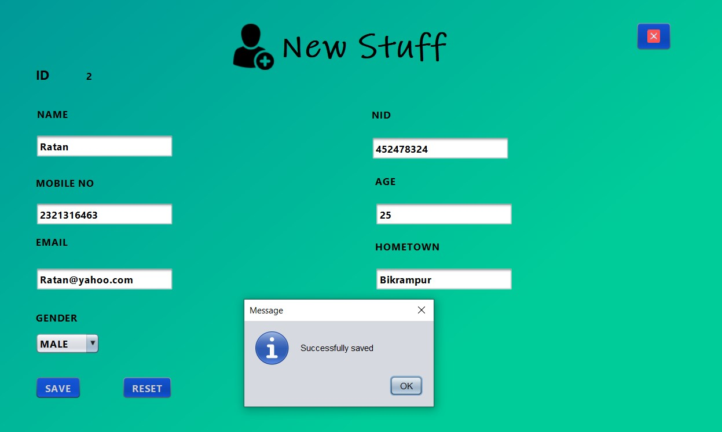
New Stuff
Adding a new stuff with necessary info

Slide 20
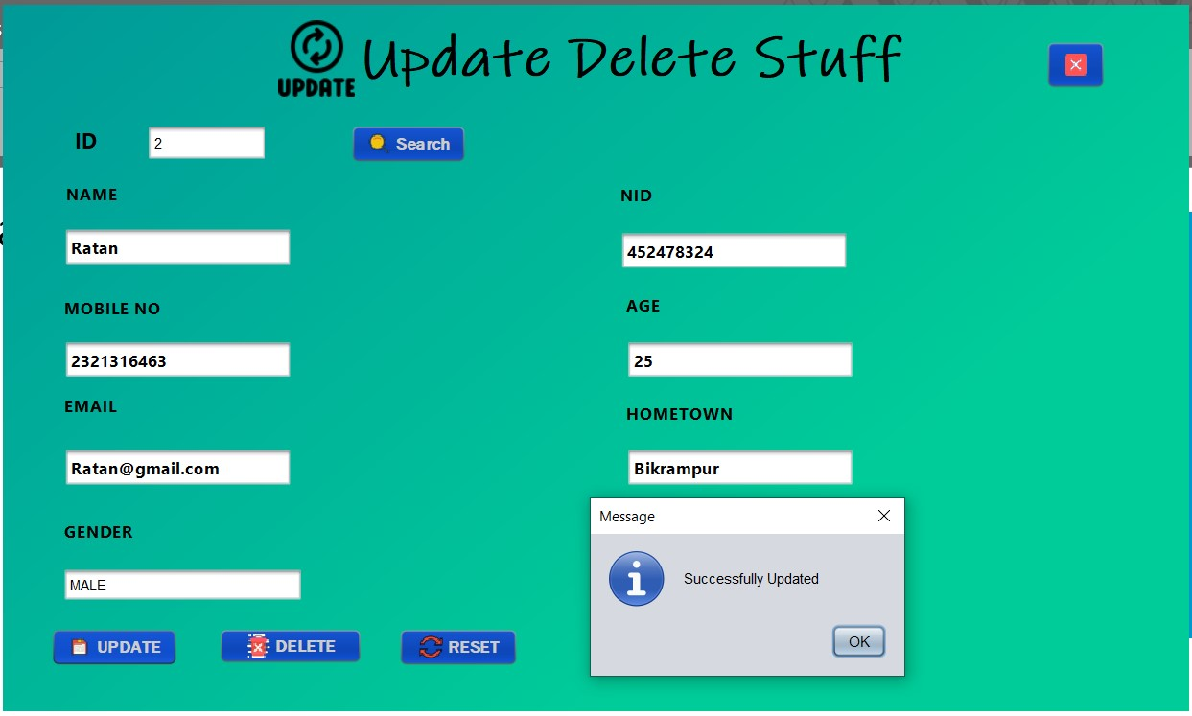
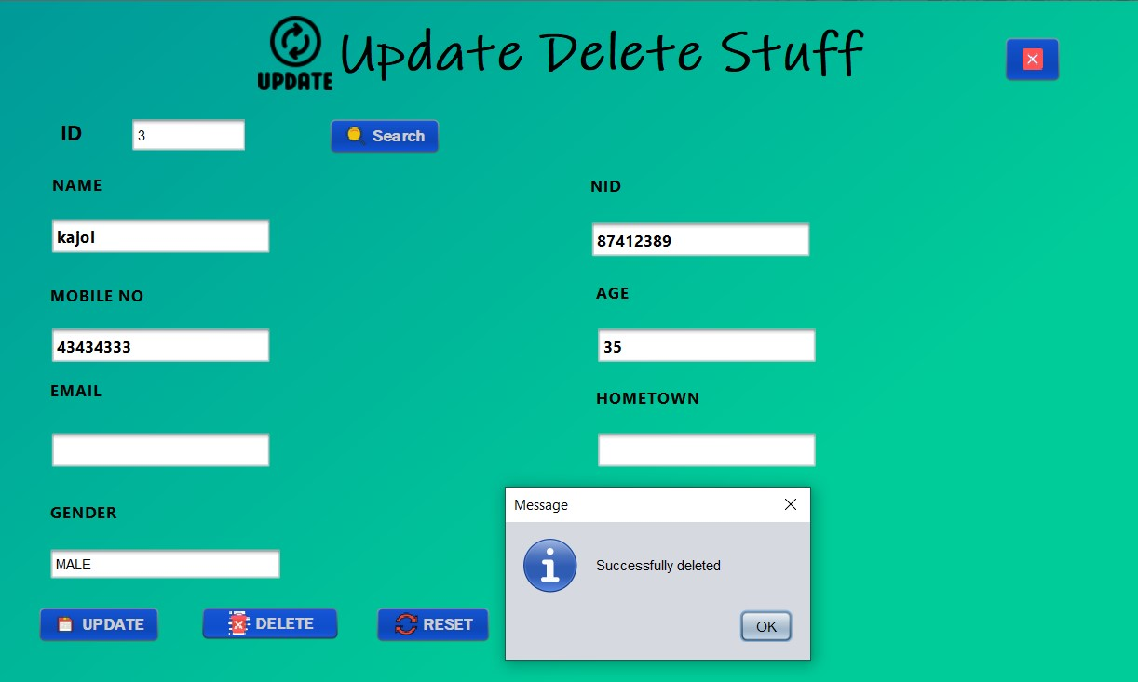
Update/Delete Stuff
Update on the left
Delete on the right

Slide 21
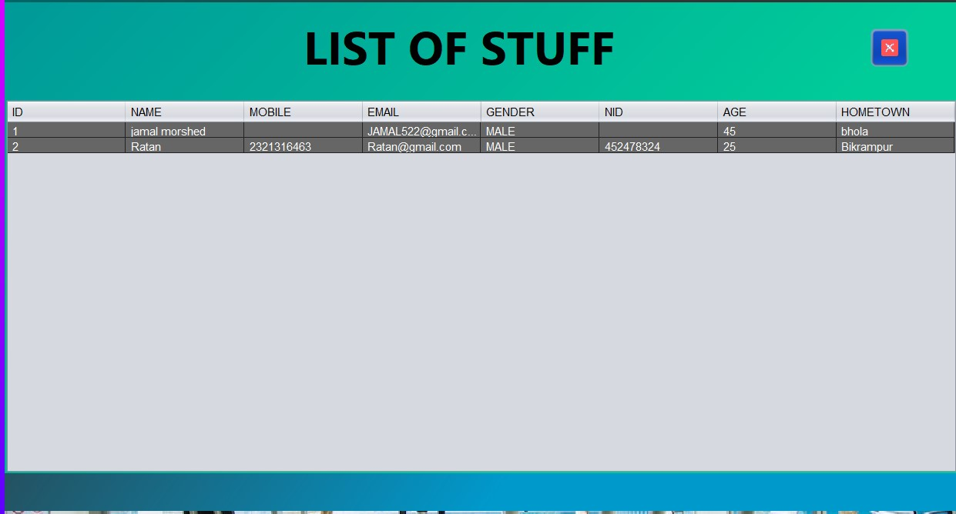
List of Stuff
Showing all the stuff as a form of list

Slide 22
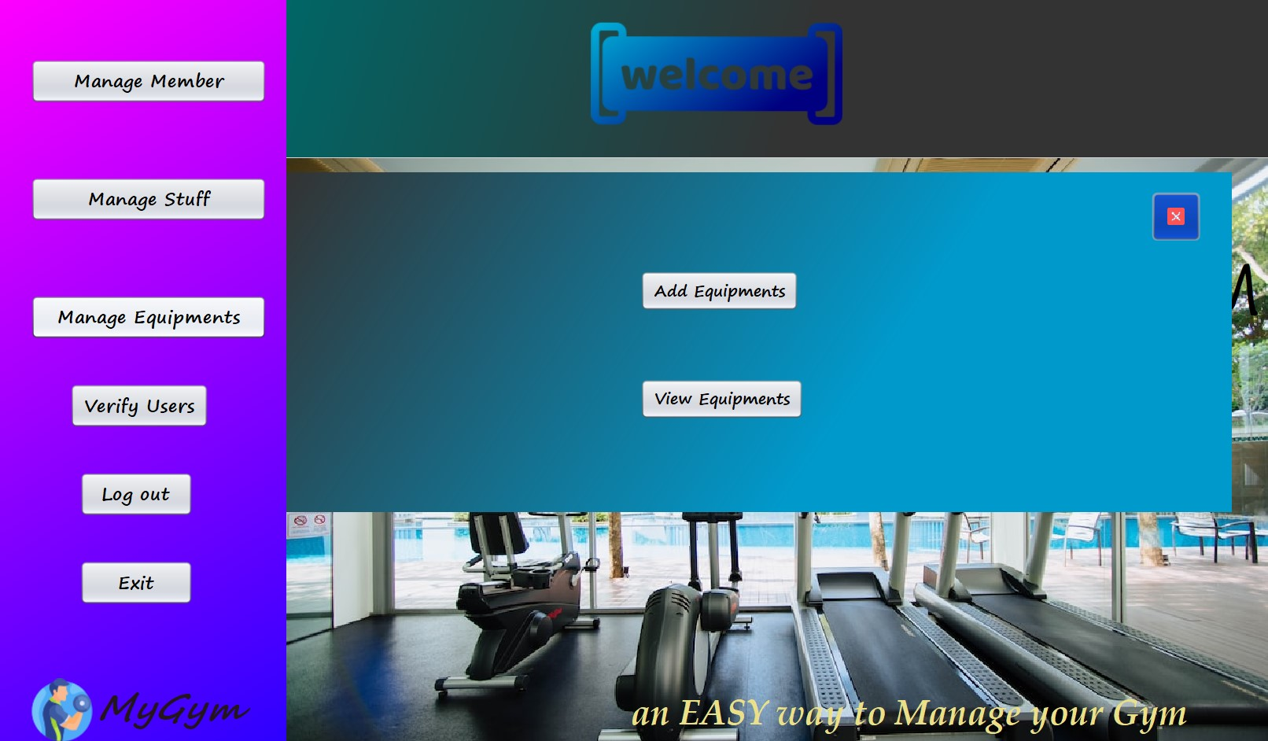
Manage Equipments
These 2 works can be done in manage stuff section

Slide 23
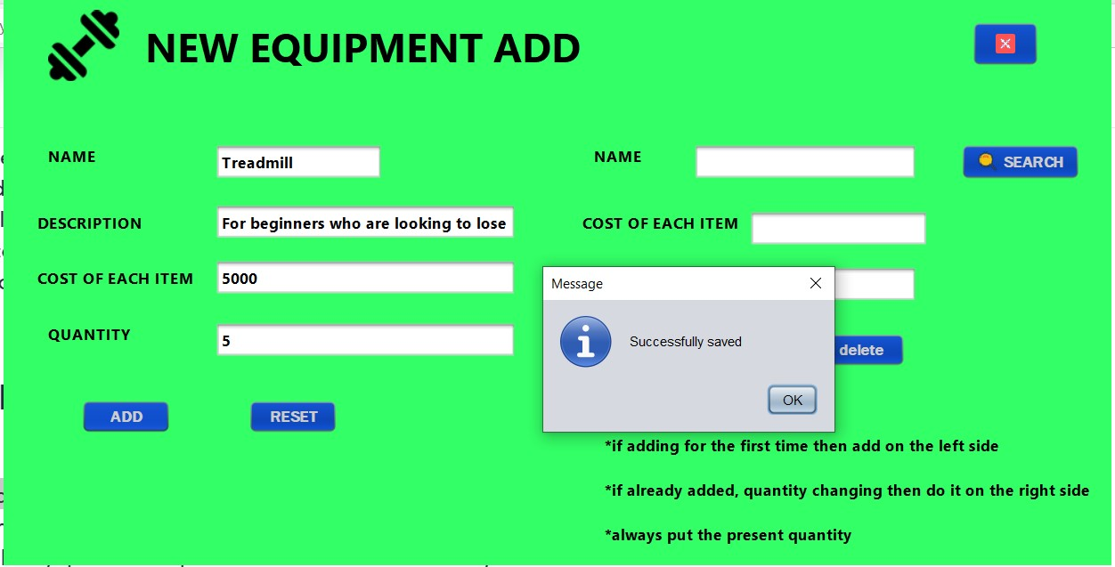
Add Equipments
After giving info then add

Slide 24
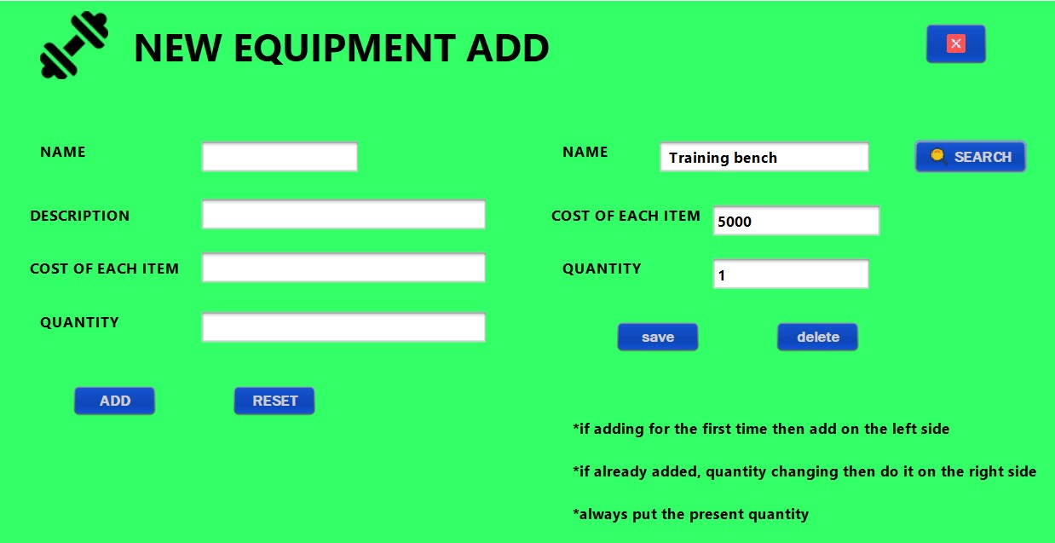
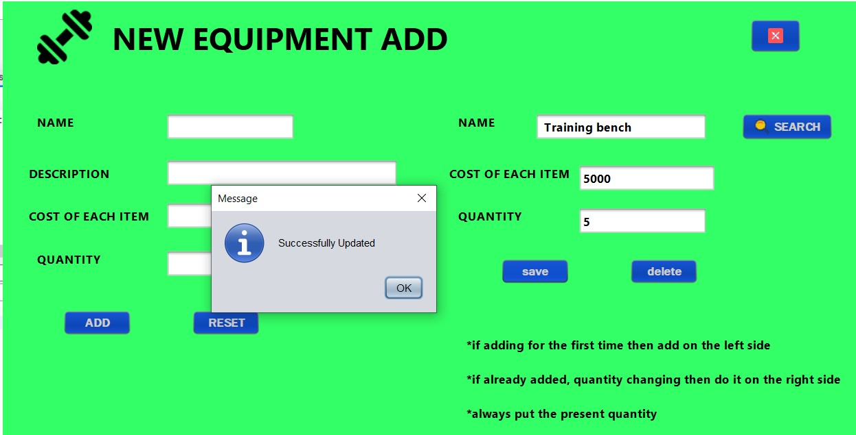
Update Equipments
If one need to change the quantity then search that item and update

Slide 25
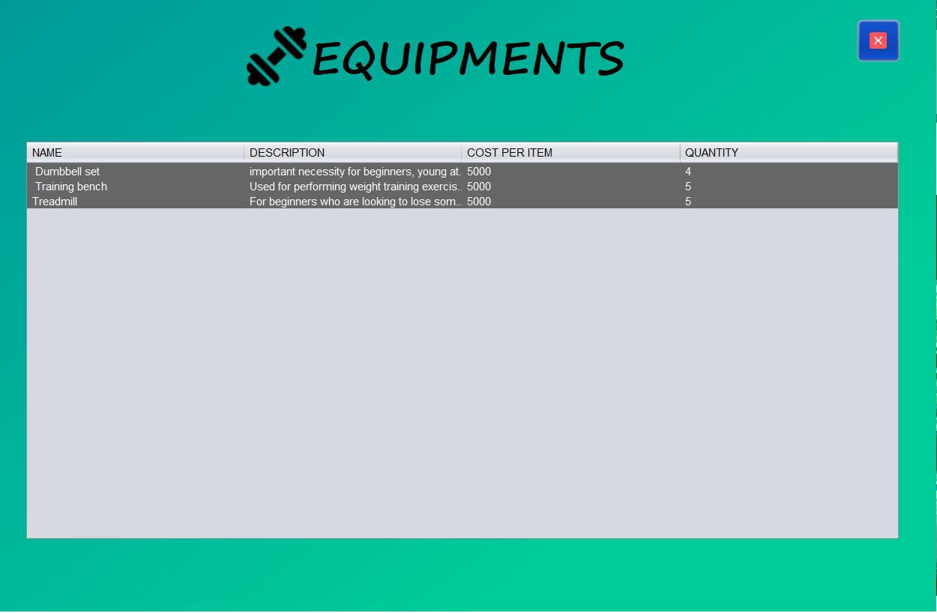
View Equipments
See all equipments as a form of list

Slide 26
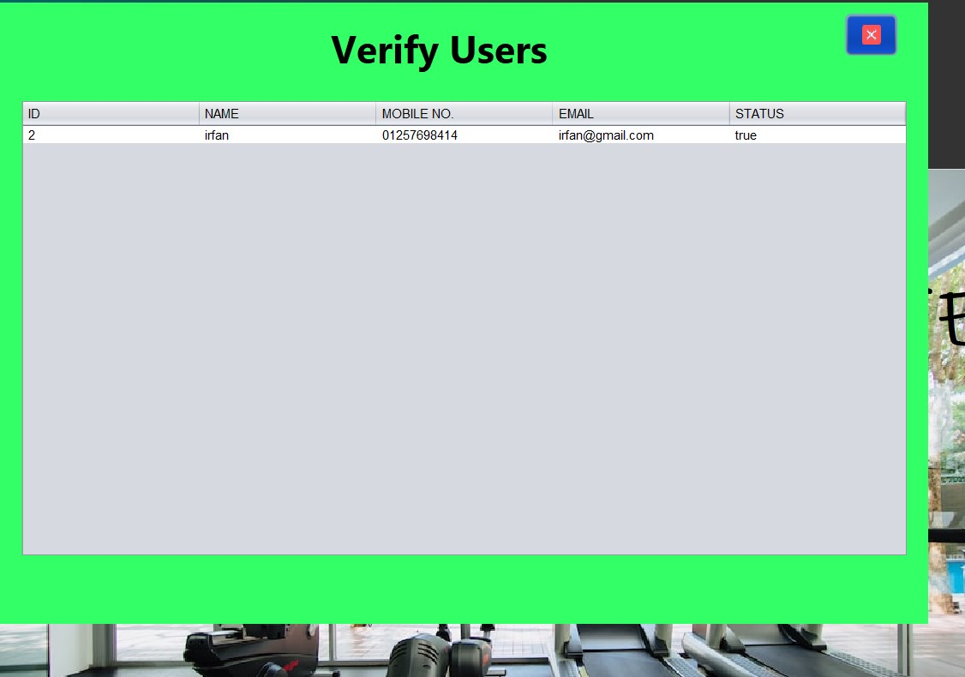
Verify Users
This table will show the user status and some necessary info.Here admin can change the status

Slide 27
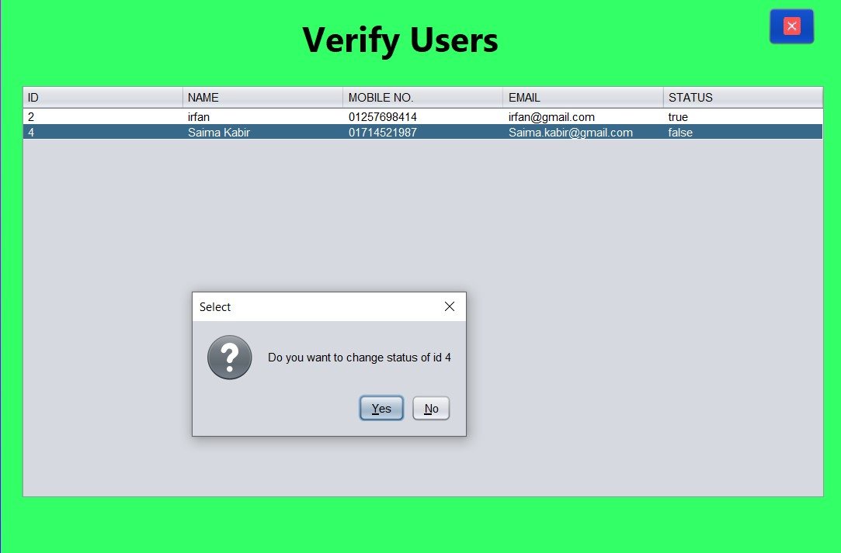
Verify Users
Here Saima Kabir is just registered.By default,the status is false.By clicking the row it will change the status

Slide 28
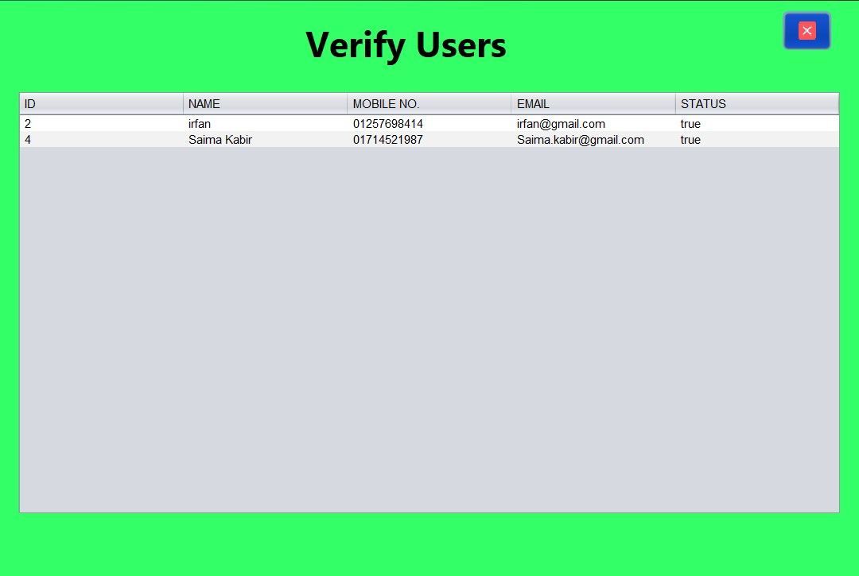
Verify Users
After updating row of ID 4 ,status is true.Now this user can login

Slide 29
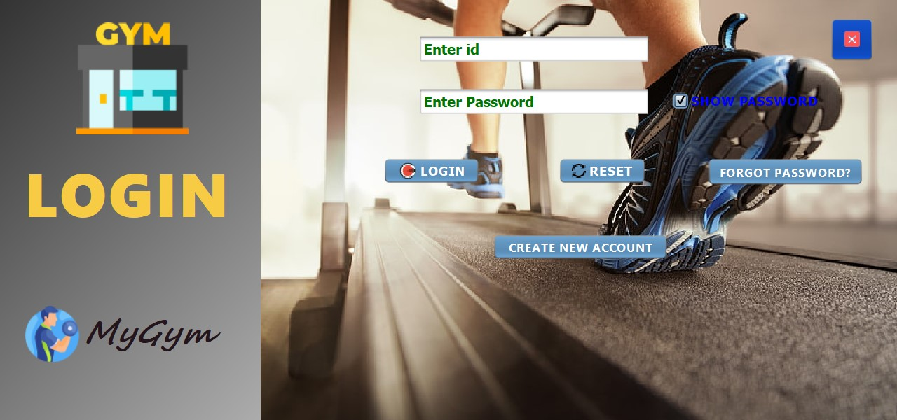
User login

Slide 30
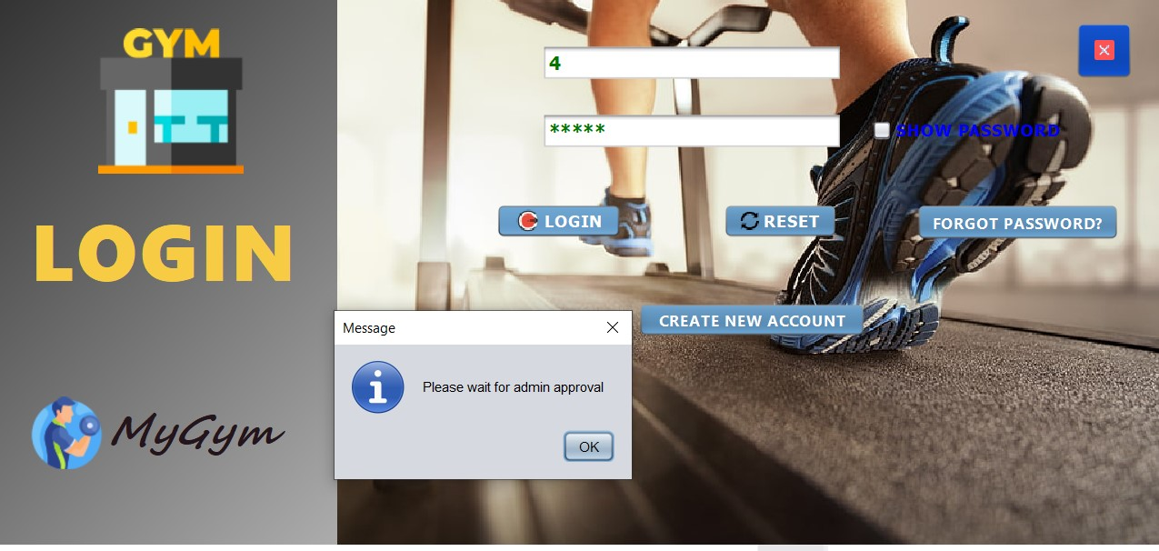
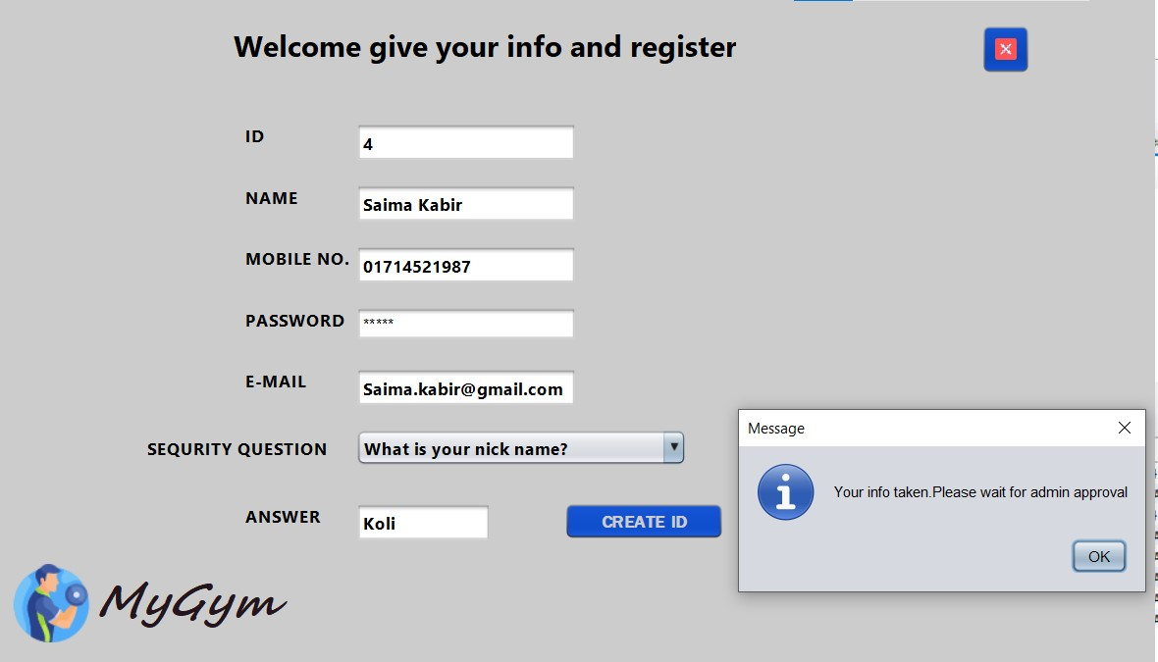
Admin approval

Slide 31
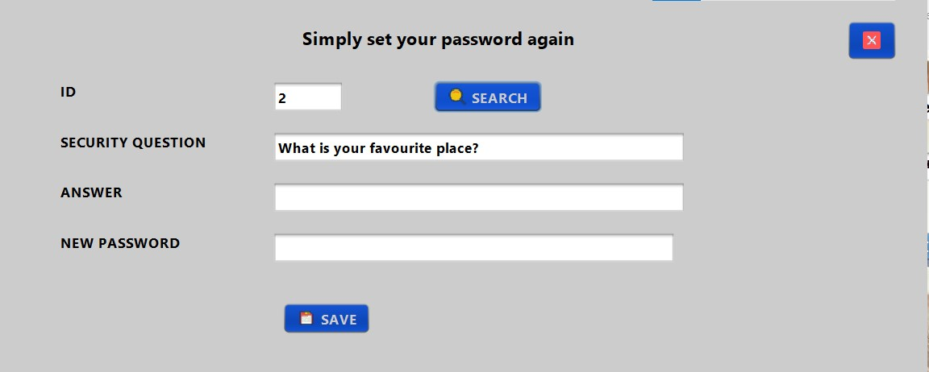
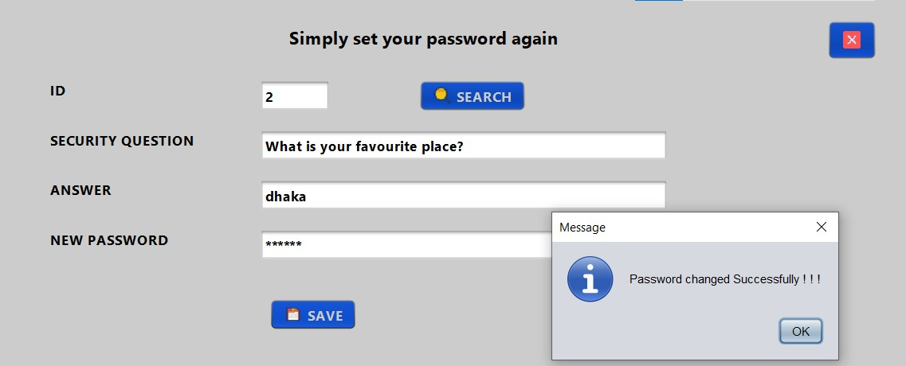
User forget password
On the left side , security question is asked for that user
On the right side after giving correct answer password is changed

Slide 32
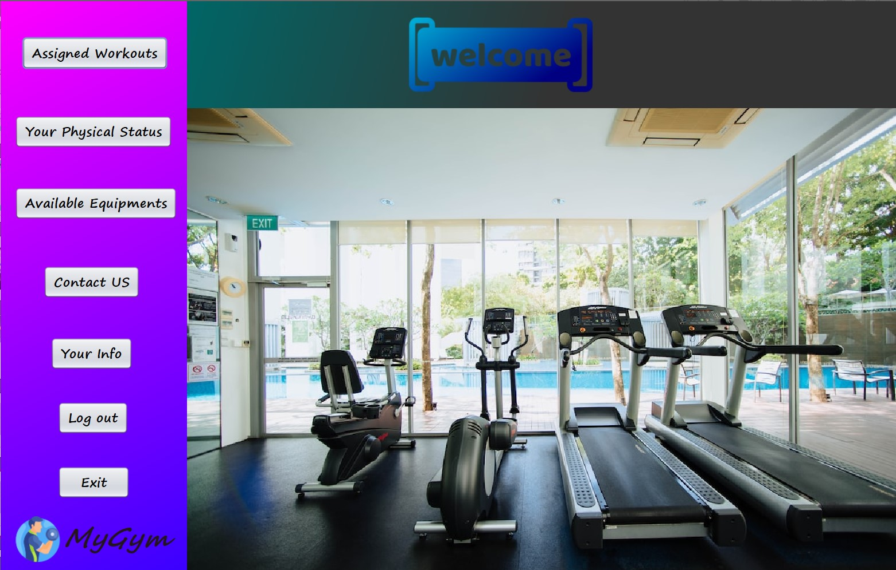
User Home

Slide 33
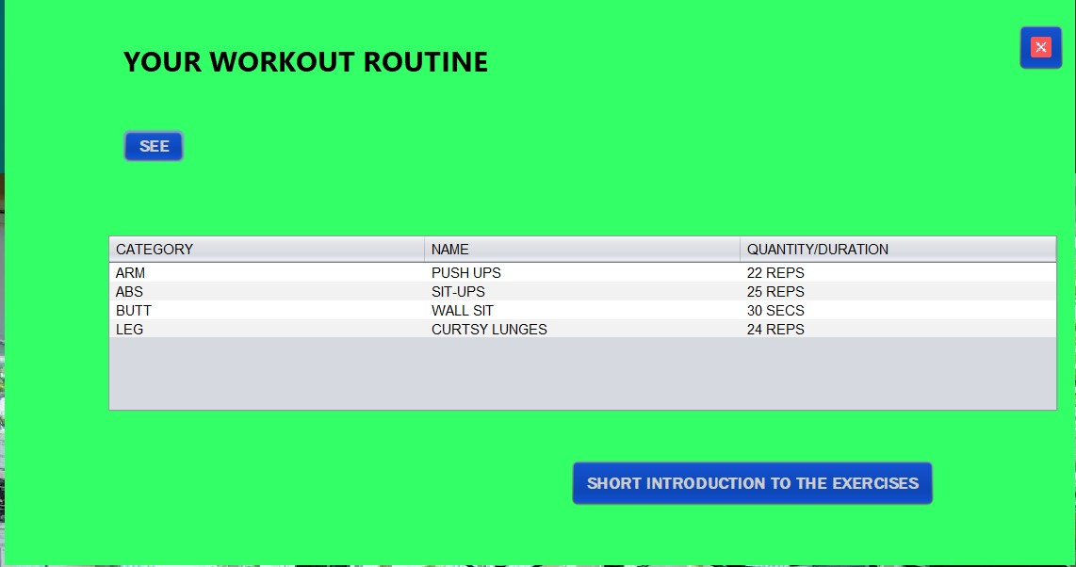
Assigned workouts
By clicking see,user will be able to see assigned workouts for him in 4 category .These are assigned by admin.

Slide 34
Short Introduction of Exercises
By clicking see,user will be able to see assigned workouts for him in 4 category .These are assigned by admin.

Slide 35
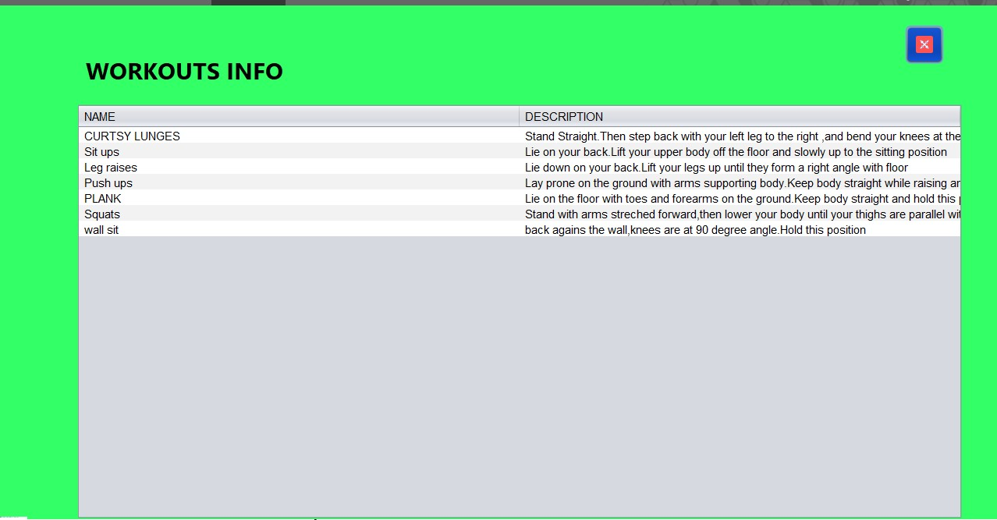
Short Introduction of Exercises
If user wants to know about any workout, the clicking here will show

Slide 36
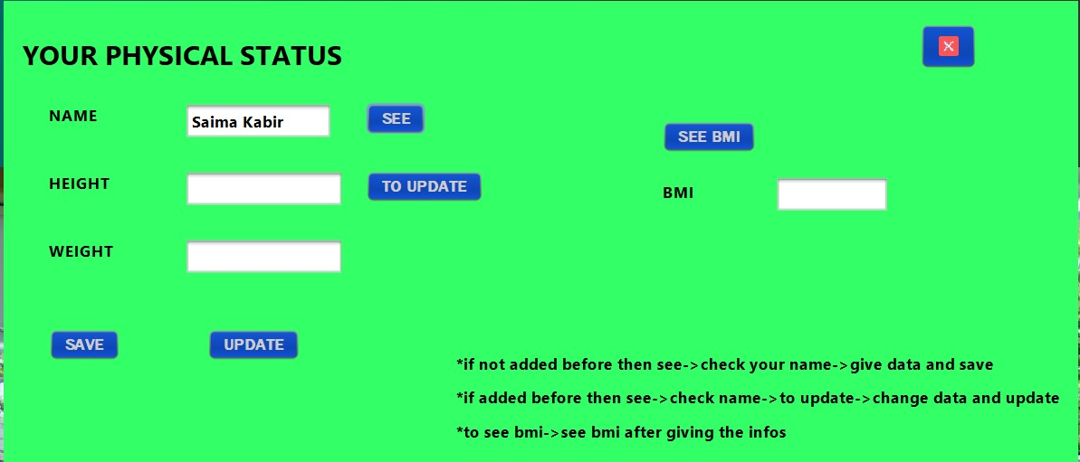
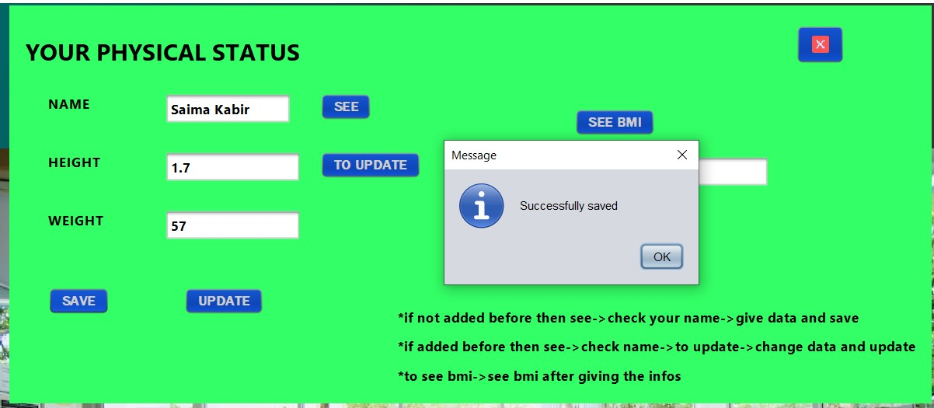
Physical Status
Adding for the first time then give info and save

Slide 37
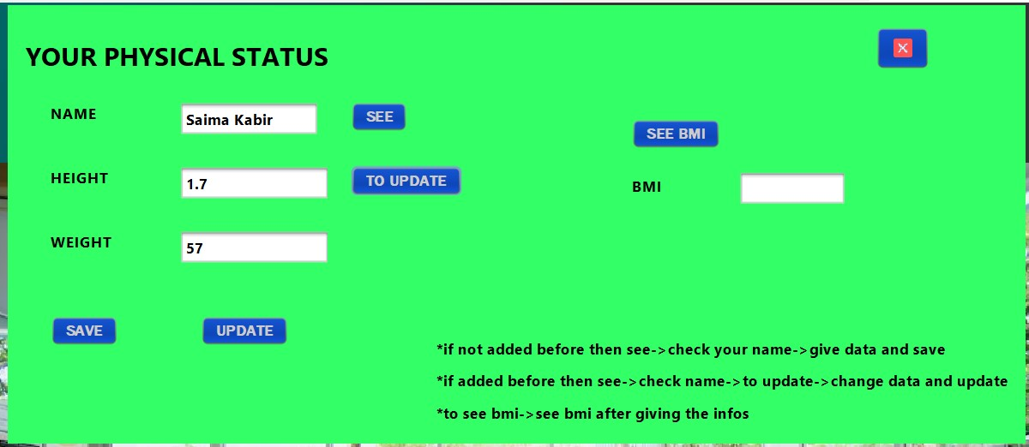
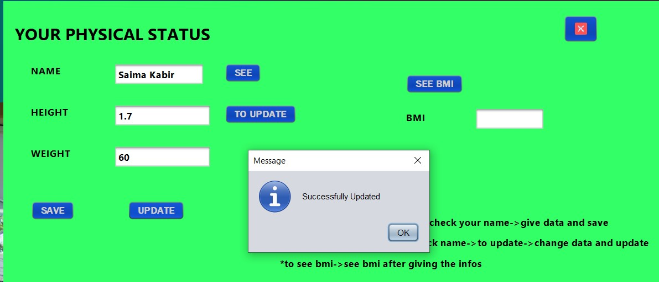
Physical Status
If already added then click to update (on the left side)
After updating(on the right side)

Slide 38
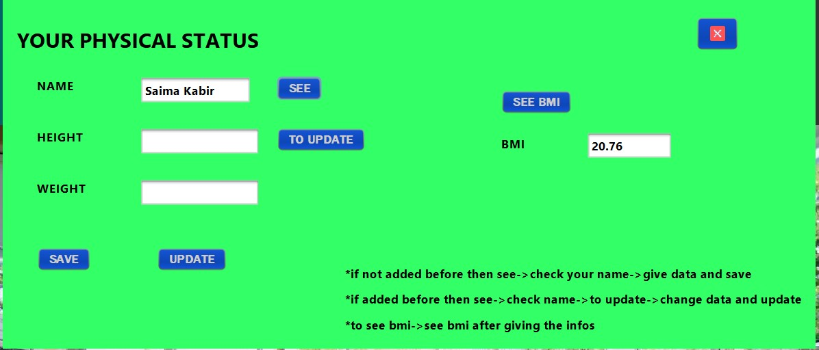
Physical Status
Clicking see bmi will simply show the BMI for that user

Slide 39
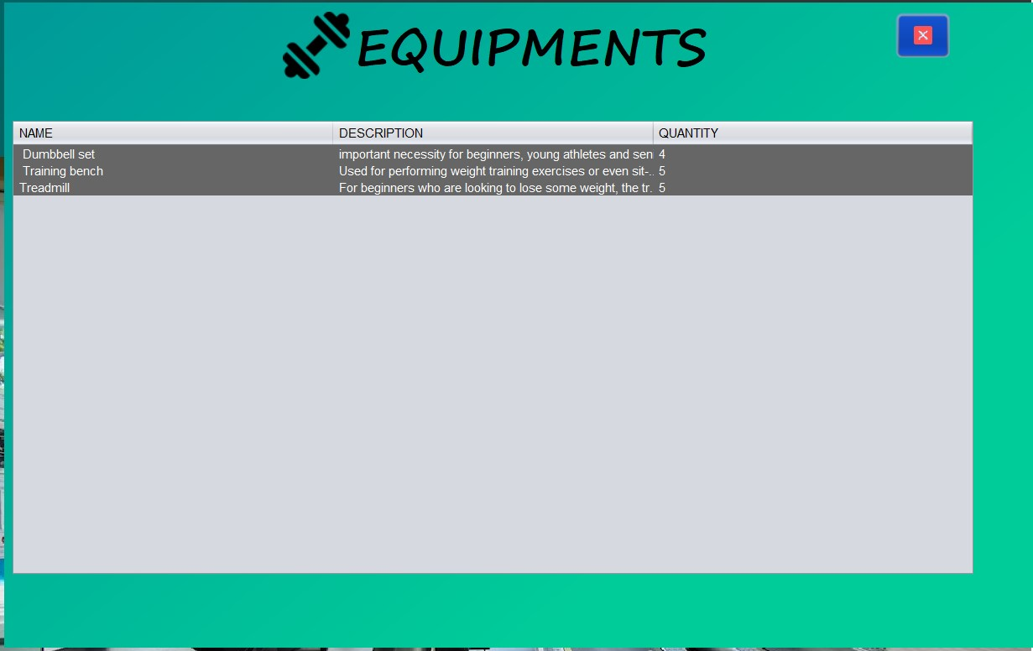
View Equipments
See available equipments in the gym.

Slide 40
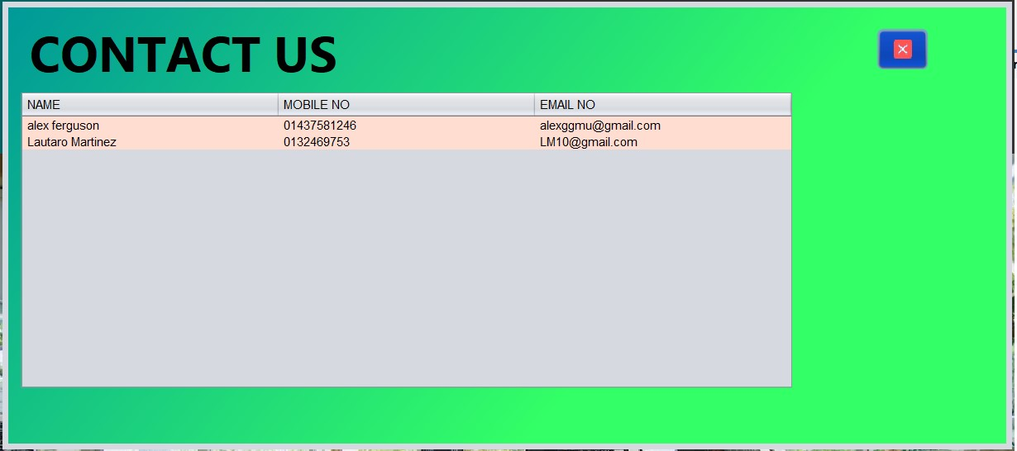
Contact Us
User will be able to see admin contact info to call for any issue

Slide 41
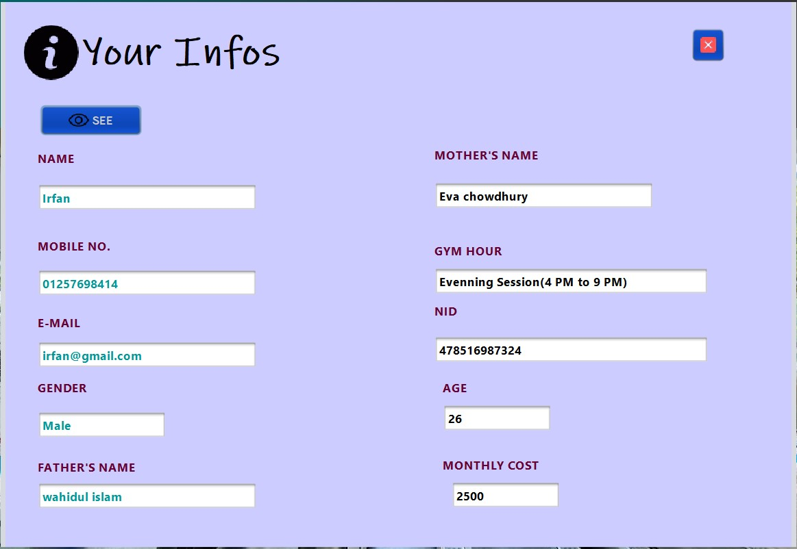
Your Info
User will be able to see what information is given to admin

Slide 42
Future plan
Add notification sending system
Texting between admin and user
Performance report of user
Diet plan for user

Slide 43
Thank You All

